Slide 1
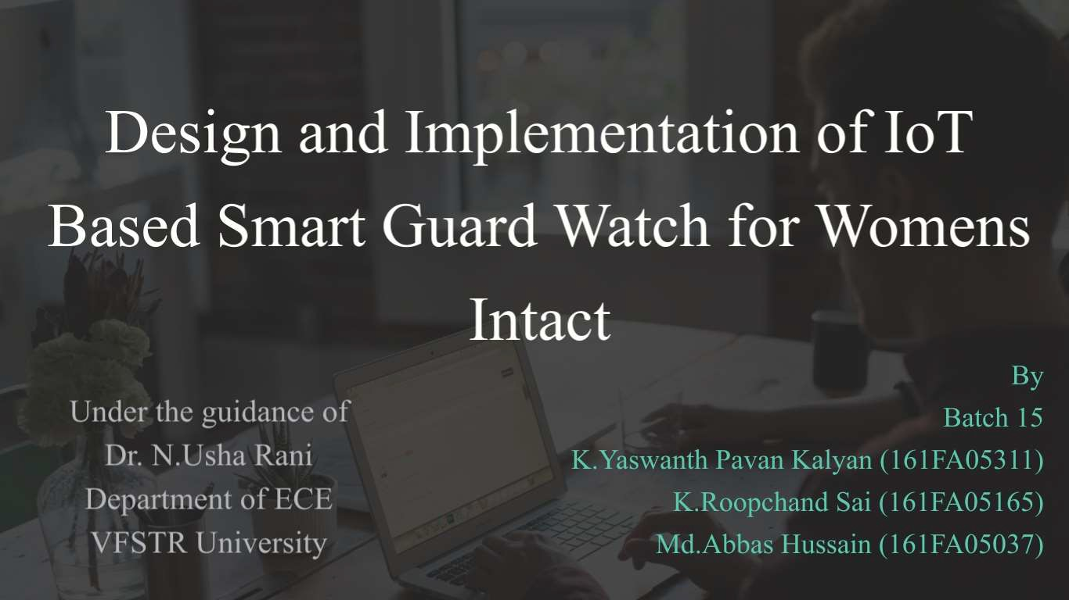


DEPARTMENT OF ECE
1

Slide 2

------INTRODUCTION------
The main objective of our project is to design the Voice
Automated Smart Watch for Women's Safety using IOT
Technology
and
Python.

Slide 3


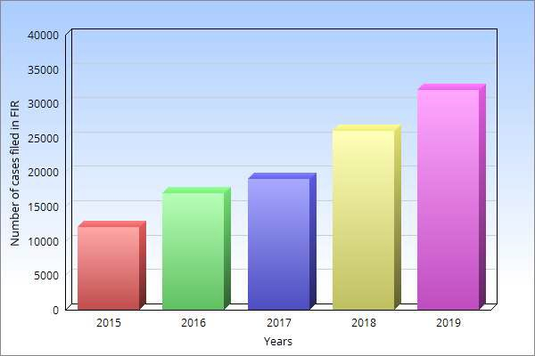
Motivation
Ramp Growth regarding Women’s Harassment cases.
In India, the average about 32000 cases has been filed regarding women harassment.
In India
→ Uttar Pradesh – 1st place
→ West Bengal – 2nd place
→ Maharashtra – 3rd place
The Indian capital Delhi is the latest safe state with a highest cognizable crime rate of about 160.4.
To limit such problems we are proposing the Smart Guard Watch for Women’s Intact was developed.
Fig.1. Year wise cases filed on women harassment
3

Slide 4

1. Video Streaming
Using Pi camera and raspbeny pi IP Address
2. Voice Automation
Using Speech Recognition 1nodule and GTTS Module
3. Sensors Interfacing
Sensors like pulse sensor and IR body temperature sensors are interfaced with raspbeny pi and display their outputs in oled Display

Slide 5

4. Live Location Tracking with Alert Messeging System
Tracking of Location of Watch using GPS module and the message alert with the help of GSM 111odule.
Calls,Messages and Notifications Alert
With the help of Bluetooth the notification alerts are displayed in the OLED Display along with the icons.
Security for Smart Watch
We are using Fingerprint Sensor for providing security for our s1nart watch.

Slide 6

Contents
Introduction to IoT Technology
Literature Survey
Architecture of our Project
→ Include Architecture, Block Diagram, System Representation of our project.
Objectives of our project
→ Include All 6 objectives that are related to our project
Algorithm
→ Include Algorithm and Flowchart of our project
Conclusion
Future Scope of our project
References
6

Slide 7
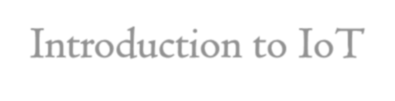
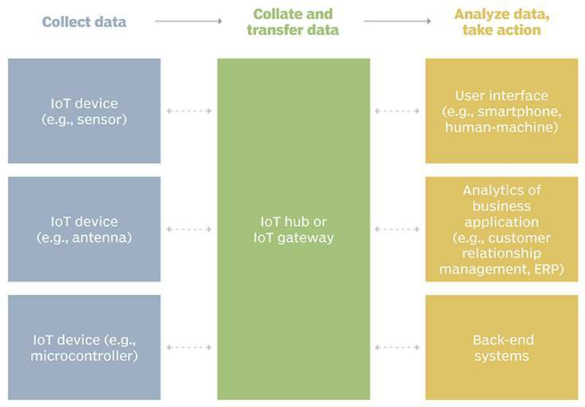
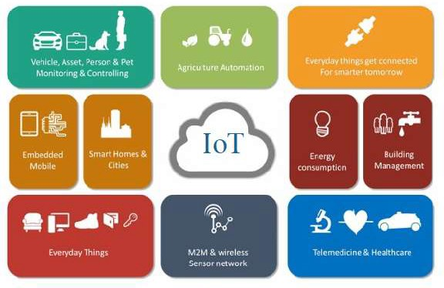
Introduction to IoT
The term “Internet of Things” was coined by entrepreneur Kevin Ashton.
Internet of Things (IoT) is nothing but connection of physical devices, sensors, actuators, electronic embedded gadgets to form a network and connected to the Internet for communication purposes.
Fig.2. IoT Device
Fig.3. IoT Applications
7

Slide 8

Literature Survey
S.no | Authors | Title | Source | Findings | Limitations
1. | Navya R Sogi, Priya Chatterjee, Nethra U, Suma V | SMARISA: A Raspberry Pi based Smart Ring for Women Safety Using IoT | International conference on Inventive Research in Computing Applications, 2018 | This process deals with the women’s safety ring, where the ring is interfaced with GSM and GPS module to raspberry pi. Here the button is used to send the alert notification and GPS tracking link to police station and family contacts. | This model doesn’t give the perfect information of the person if he holds the hand tightly at some times
2. | Surekha Goankar and Mrs. Meghashree AC | Emergency Tracking System for Women Using Body Sensors via Wrist Watches using Internet of Things (IoT) | International Research Journal of Engineering and Technology | Here, pulse rate, temperature sensor, vibration sensor is also used. Here, if the threshold of any sensor increases then GSM alert system will go to the family and police station.. | Here the sensors doesn’t show the values when it is needed and if vibration increases due to the sudden movement of hand, then the alert message will go, which is a drawback
3. | Mahejabeen Budebhai | IoT Based Child and Women Safety | International Journal of Computer Science and Mobile Computing, Vol, 7. 2018 | Here, the sensors such as temperature sensor, heart beat sensor, panic button are interfaced with raspberry pi. GSM and GPS send the message to family with line location. Here, micro phone also interfaced to record the voice and to activate the panic button to send alert message to the source. | Here the pulse sensor value crosses the threshold value ,then automatically triggers the Raspberry Pi, but in some cases pulse sensor gives values in some other situations also, and this sensor is not accurate one. 8

Slide 9
S.no | Authors | Title | Source | Findings | Limitations
4. | Dr. G.Sivasankari, Prerana G Joshi | Live Video Streaming using Raspberry Pi in IoT Devies | International Journal of Engineering and Technology, 2017, Vol.5 | If anybody moves near the camera, it starts capturing the information. Here the video is captured by raspberry pi camera. To stream the video, the Ethernet cable was connected and stream the data to the cloud. | Here in this paper there are no limitations.
5. | Geetha Pratyusha Miriyala, P.V.V.N.D.P.Sunil, Ramya Sree Yadlapalli, Vasantha Rama Lakshmi Pasan, Tejeshwini Kondapalli, Anusha Miriyala | Smart Intelligent Security System for Women | International Journal of Electronics and Communication Engineering and Technology, 2016 | This paper utilizes the raspberry pi 2 in great manner. Here the raspberry pi is interfaced with GSM and GPS where alert data is required in the android secure connected phone. Here the camera captures the video and likewise also saves it in the webserver. Here, the teargas is used. It mistaking if the button was pressed, it causes a great issue that the gas will spill out. | It mistaking if the button was pressed, it causes a great issue that the gas will spill out spectacles. If teargas spills, it causes damage even to women’s eyes also.
6. | C. Priya, Ramya C, Befy D, Harini G, Shilpa S, Sivani Kiruthiga | One Touch Alarm for Women’s Safety using Arduino | International Journal of Innovative Technology and Exploring Engineering | Touch sensor, GSM, teargas mechanism, GPS with buzzer alert systems were installed. Here, by activation of touch sensor sends the alert message to police and family with live tracking of GPS link and suddenly the teargas mechanism switch on which is used to spray on the person’s eye and even at a second alarm system switch on. | In this project touch sensor used is a drawback because touch sensor switches on even if it touches the any part of the body skin. 9

Slide 10
S.no | Authors | Title | Source | Findings | Limitations
7. | S.A. More, R.D. Borate, S.T. Dardige, SS.Sekhar, Prof. O.S.Gogawale | Smart Band for Women Security Based on Internet of Things | International Journal of Advance Research in Science and Engineering, November 2017, Vol.06, Issue No.11 | This paper is mainly focused on the GPS location tracking and GSM message alert system. Here, the authors have interfaced pulse rate sensors and temperature so that to monitor the body conditions of the client. Here, via the Bluetooth module the sensors data will be send to the mobile application where they can monitor at every time | The limitation is this is the alert system can be ON only with the mobile phone and the watch must be via Bluetooth
8. | B.Sathyasri, U.Jaishree Vidhya, G.V.K. Jothi Sree, Pratheeba, Ragapriya | Design and Implementatio n of Women’s Safety System based on IoT Technology | International Journal of Recent Technology and Engineering, Vol.7, Issue-63, April 2019 | This project is implemented with ATMega 2569 microcontroller. Here the press button sends the GSM Message of the current GPS location. Here, they have used the neuro simulator and vibration sensor. Neuro simulator senses the nervous system of the women in such conditions. If the simulator is ON, then it apply shock to the attacker. | Here the limitation is watch battery they have used doesn’t cause much attack to the attacker if he holds the hand of the lady.
9. | Shreyas R.S, Varun.B.C, Shiva Kumar. H.K, Punith Kuar B.E, Kalpani.C.Y | Design and Development of Women Self Defence Smart Watch Prototype | International Journal of Advanced Research in Electronics and Communication Engineering (IJARECE), Vol.5, Issue-4, April 2016 | Here with the help of microcontroller the panic button is interfaced. It sends the GPS location with the help of GSM to the police station and family at the same time with the help of relay shock generator is used and at the same time the buzzer will switch ON for alert system. All the data is shown in the LCD Display. | Here, the limitation is heavy battery is required for shock generator which is no practically impossible and it doesn’t harm the attacker if he holds the hands.
10

Slide 11
S.no | Authors | Title | Source | Findings | Limitations
10. | Aswini A, PG Scholar and Dr.J.Preethi | Smart Self- Defense Gadget for Women’s Safety Using IoT | International Journal for Research in Engineering Applications and Management, ISSN: 2454-9150, special Issue-NCCT-2018 | In this system, the module is offline for sending alert message and GPS tracking location to the family and police-station and other is online, which records the audio recording and uploads the data to the cloud. Here, the pulse shock generator is also interfaced. If the pulse increased, then shock automatically generates. | The limitation is that if pulse increased due to the horror effects or some of the dare games in exhibitions or excluding, then the shock generator ON and generated shock which is wastage of battery and due to this the women wearing watch also effected by shock in some cases
11. | Mr. Pampapathi B.M, Komal Singh, Madhavi V, Madhu B Yallamaddi, Mangala Desai | Smart Band for Women’s Safety Using Internet of Things (IoT) | International Journal of Advanced Research in Computer and Communication Engineering, Vol.7, Issue 3, March 2018. | This paper has an arduino microcontroller. Here, the pulse rate sensor and temperature sensor are interfaced and also Bluetooth module is used to connect to the app in the phone. Here, the no external GSM and GPS is used. They have used the phones GPS location. In case of emergency, the women makes use of the phone application. By pressing the application in phone, the GPS location will send to the police station. | The limitation is the model is possible only when internet is ON and in such case of emergency the women can’t use the phone to send the GPS location.
11

Slide 12

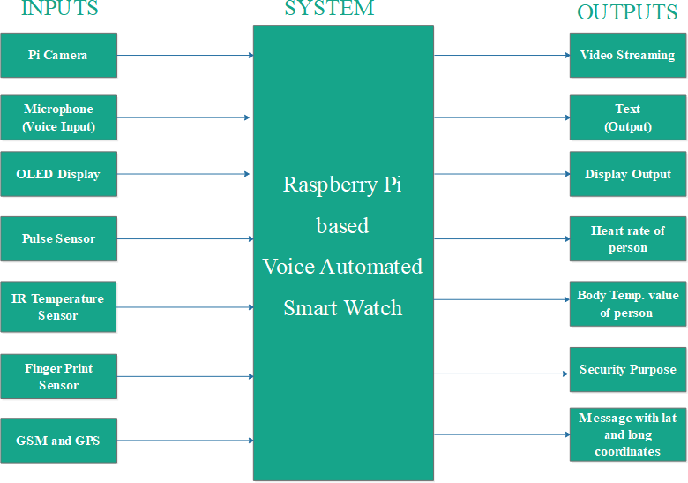
System Representation
Fig.4. System Representation of Smart Watch
12

Slide 13
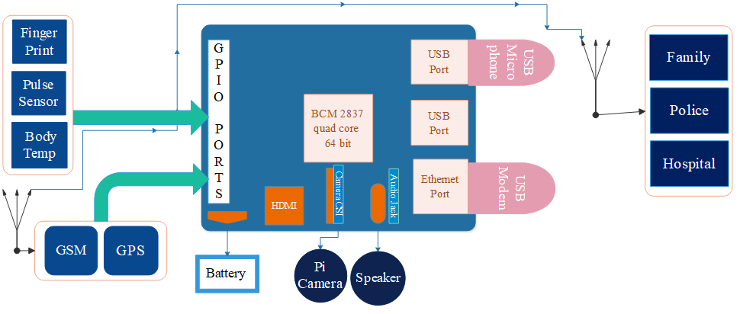
Architecture
Body Sensors
Client Devices
Fig.4. Architecture of our Smart Watch

Slide 14
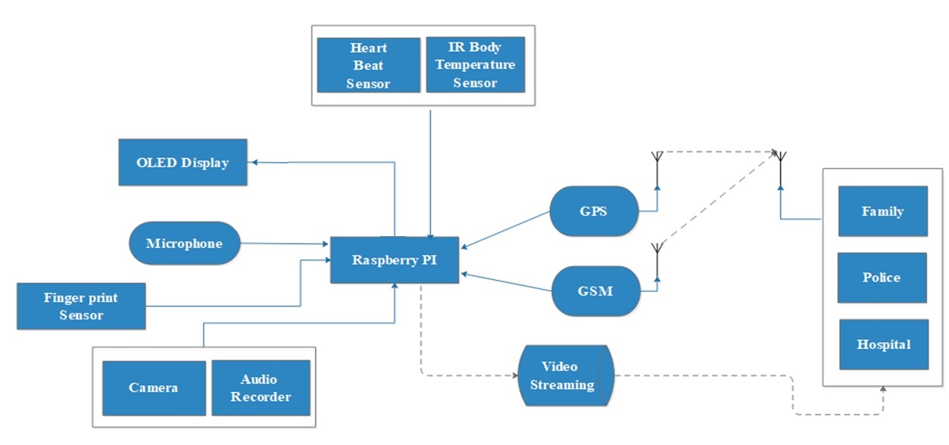
Block Diagram
Fig.5. Block Diagram

Slide 15

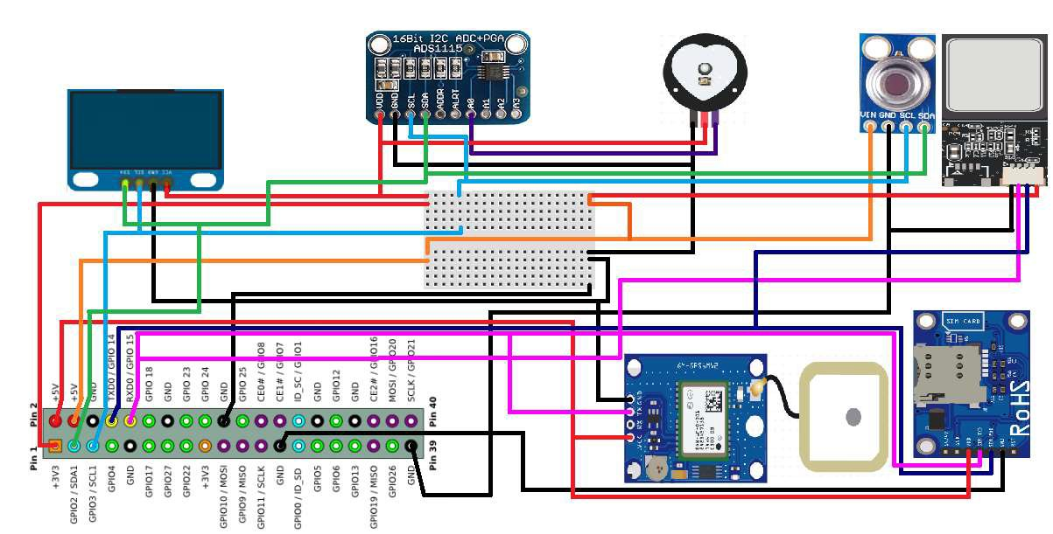
Circuit Diagram
Fig.6. Circuit Diagram
15

Slide 16


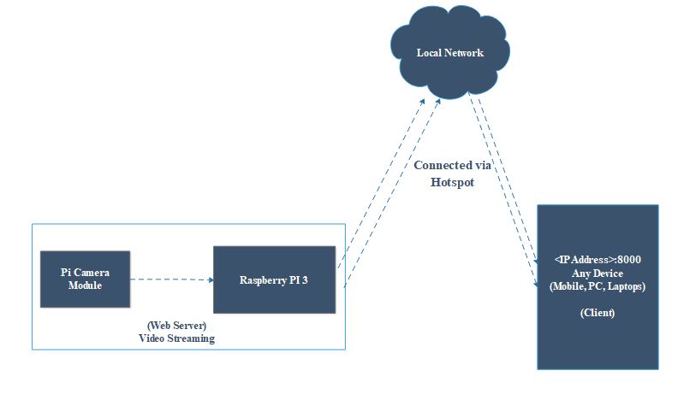
1. Video Streaming
Fig.7. Video Streaming with in a Network
Live Video Streaming using Web-Server to Client Data Transfer Protocol
Raspberry pi with pi-cam module acts as web-server for live video streaming
client devices can access the RPI <IP-address >:8000
When both server and client are connected to same network.
16

Slide 17
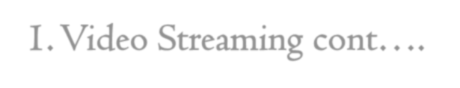
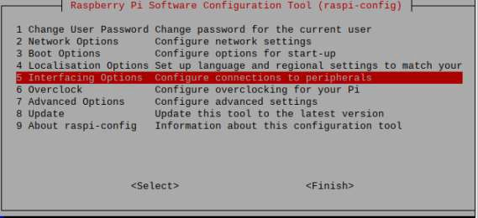
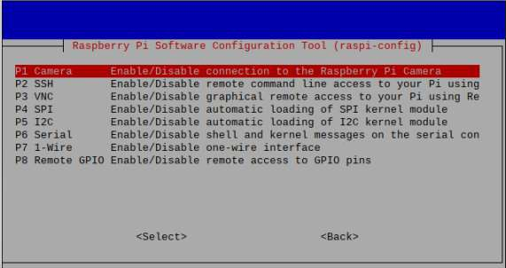
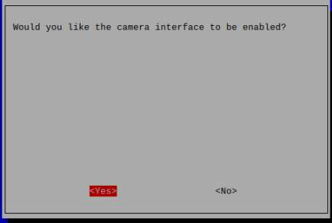
1. Video Streaming cont….
To Stream live video into a Web-Server page that can be accessed through any Client device ,
Libraries Required:
Algorithm for Video Streaming
Step 1:Enable the Raspberry Pi Camera Module.
Step 2:Find the Raspberry Pi IP Address.
Step 3:Connect the camera.
Step 4:Write the Python Script
Step 5:Accessing the Video Streaming
IO Library
Pi Camera Library
Logging Library
socketserver Library
Step 1.Enable the Raspberry Pi Camera Module
By default it is Disabled,
Raspberry Pi Configuration Interfacing options
Enable Camera.
17
Fig.8. Enabling Camera module in Raspberry Pi 3

Slide 18
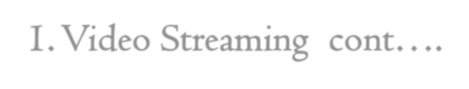
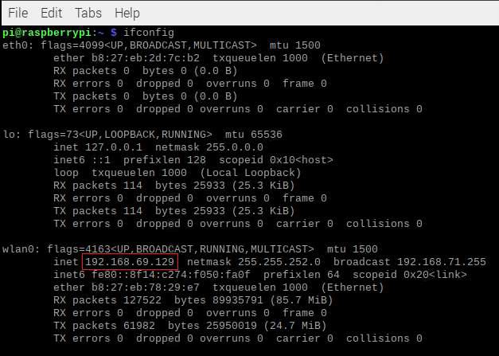
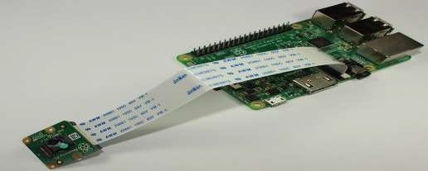
1. Video Streaming cont….
Step 2: Find the Raspberry Pi IP address
In Computer Network’s , Every Electronic Device is identified based on IP-Addresses
Algorithm for Video Streaming
Step 1:Enable the Raspberry Pi Camera Module.
Step 2:Find the Raspberry Pi IP Address.
Step 3:Connect the camera.
Step 4:Write the Python Script
Step 5:Accessing the Video Streaming
only. $ ifconfig
Shows Wi-fi Card (WLAN0) configuration details along with Raspberry IP address is
192.168.69.129
Step 3. Connect the camera
Connect the camera to the Pi CSI port
18

Slide 19



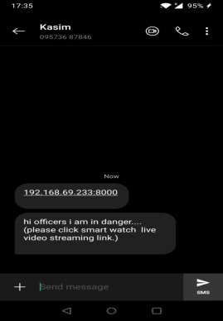

1. Video Streaming cont….
Algorithm for Video Streaming
Step 1:Enable the Raspberry Pi Camera Module.
Step 2:Find the Raspberry Pi IP Address. Step 3:Connect the camera.
Step 4:Activating the Python Script Step 5:Accessing the Video Streaming
Step 4. Activating the python script
Initiates Socket port addresses to assign Web-Server at 8000 port for Data Transfer protocols
Activates live video streaming from pi-camera module
Sends SMS notification to Client Devices
5.Accessing the video streaming
Client Devices can access your video streaming web server at: http://<Your_Pi_IP_Address>:8000 http://192.168.68.129:8000.
After clicking this link the video streaming starts in your mobile. This message is sent with the help of GSM Module
Both client device and Web-server system has to be connected to
the same network.
Fig.9. Message showing Video Streaming link
19

Slide 20
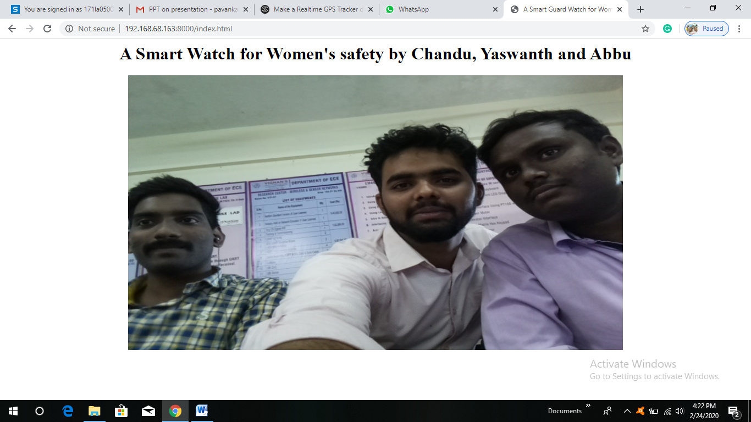
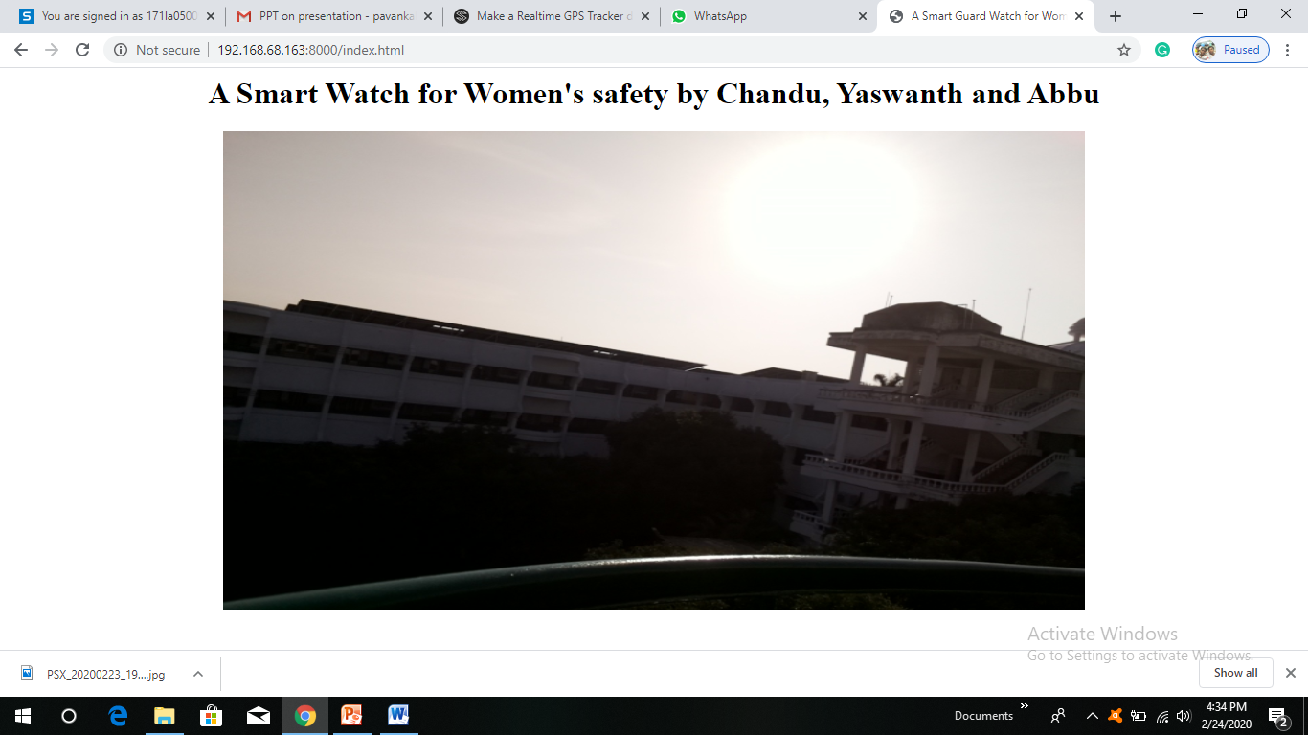
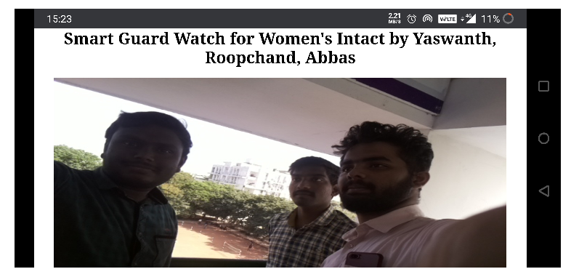
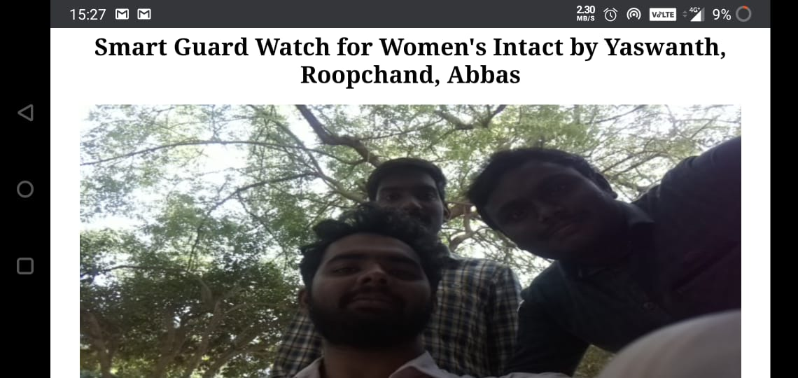
Client Device - Laptop
Fig.10.Video Streaming (Embedded Systems Lab)
Fig.11.Video Streaming (H-Block)
Client Device - Mobile
Fig.12.Video Streaming (Balcony)
Fig.13.Video Streaming (H-Block)

Slide 21
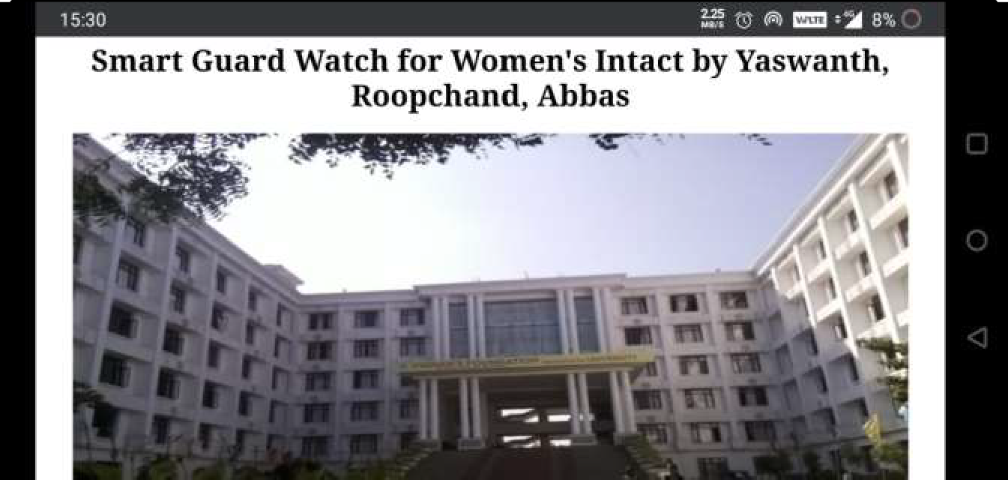
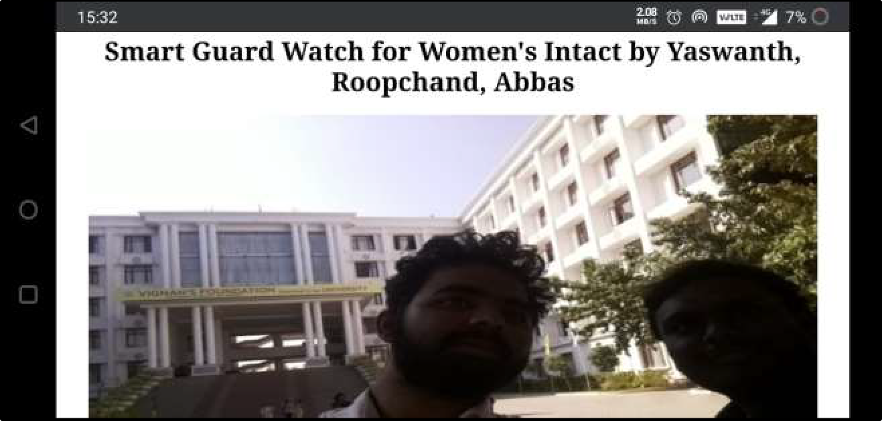
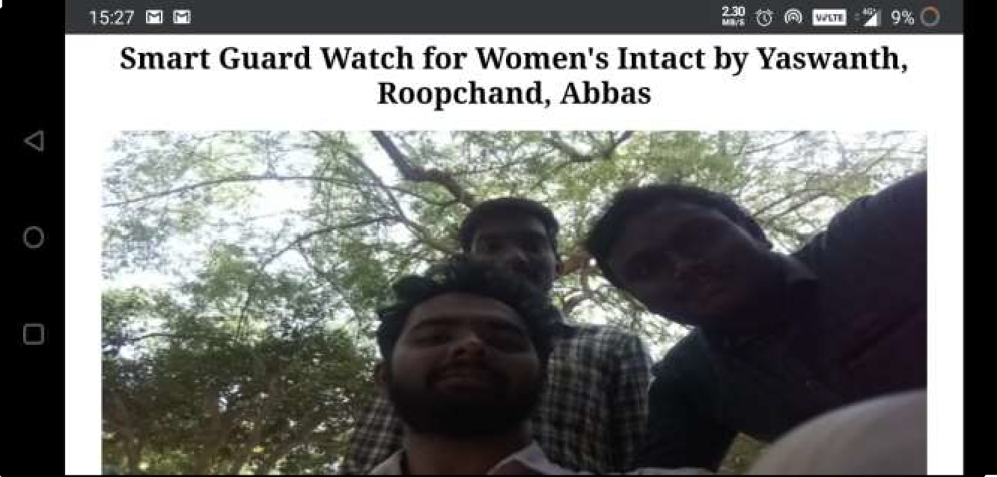
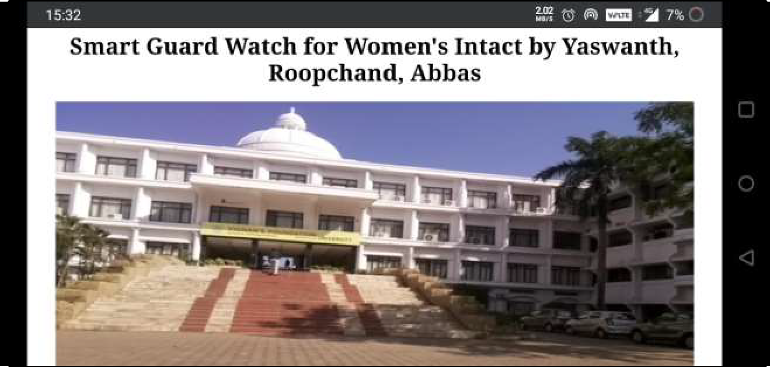
Range of Communication (Live Video Streaming)
Fig.14.Video Streaming (A-Block)
Fig.15.Video Streaming (At the A-Block)
Fig.16.Video Streaming (Outer Garden of A-Block)
21
Fig.17.Video Streaming (Main Entrance)

Slide 22
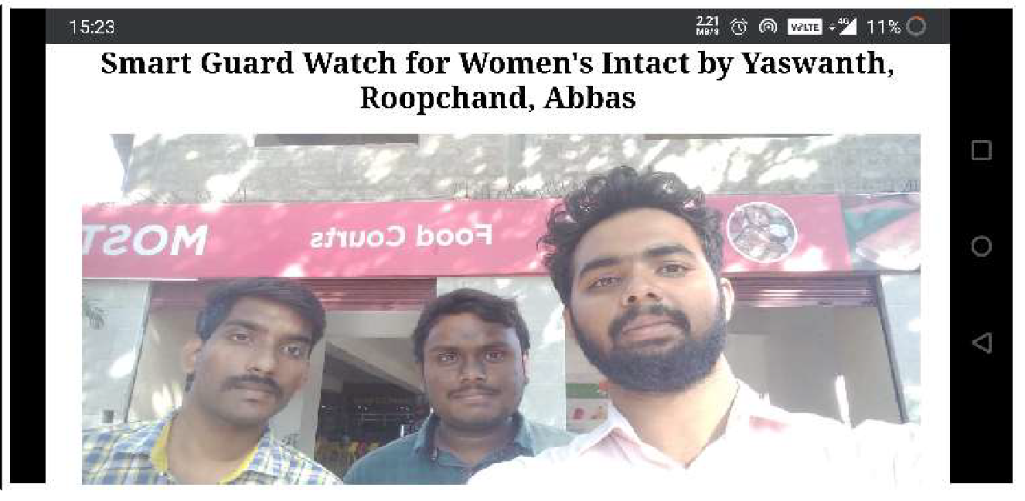
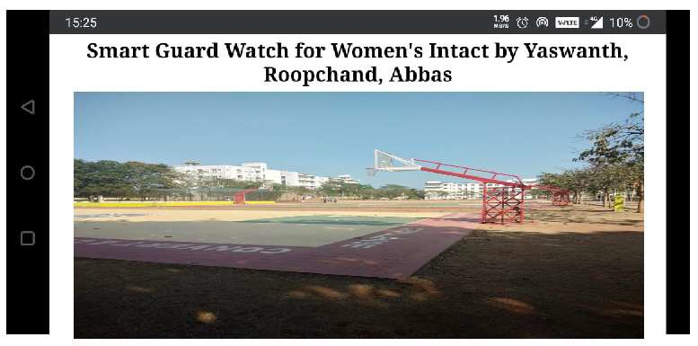
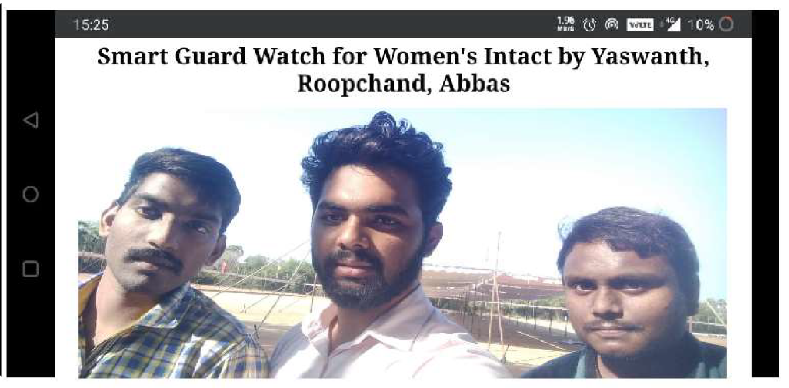
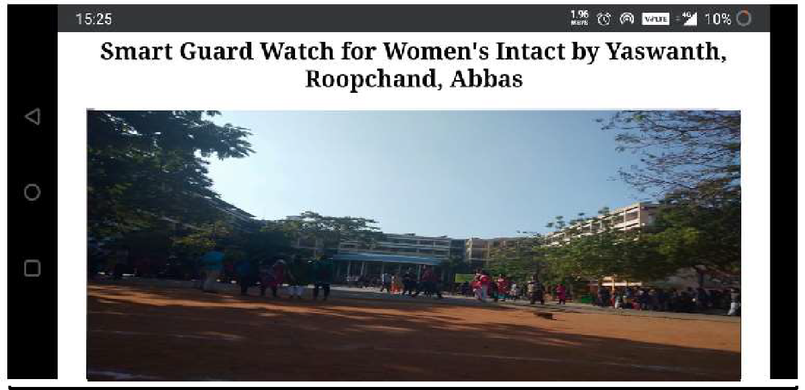
Range of Communication (Live Video Streaming)
Fig.18.Video Streaming (MHP Canteen)
Fig.19.Video Streaming (Basket ball Court)
Fig.20.Video Streaming (U-Block Ground)
Fig.21.Video Streaming (U-Block)
22

Slide 23

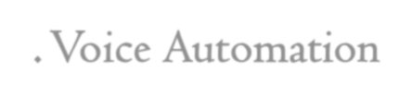
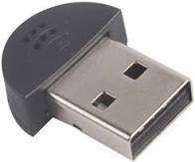
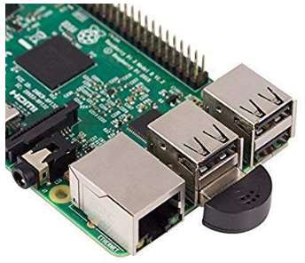






2. Voice Automation
To Receive our Voice commands and perform the related task , We Use
Recognize spoken voice (Speech recognition
Output Voice Alert’s (Text to speech)
“Provided by Google API services”
)
Step 1.Recognize spoken voice
Python Speech Recognition module converts spoken words into text.
Fig.21 USB 2.0 Microphone for RPI
It sends input recorded speech to Google Database where user speech is analyzed to match with related Text Sentences
Input speech “pyaudio”(python module)
Microphone
Google Speech API Speech to Text Analysis Google Cloud
Output Text Text sentences OLED Display
23

Slide 24
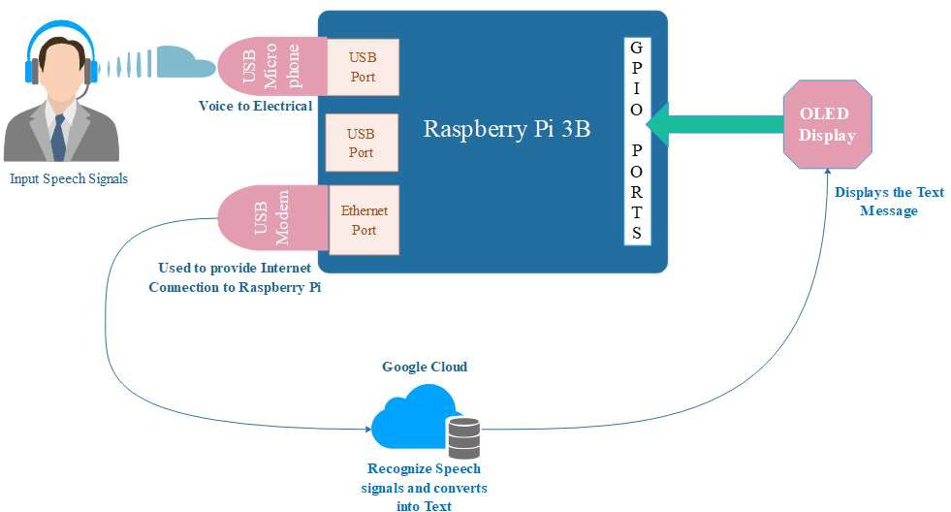
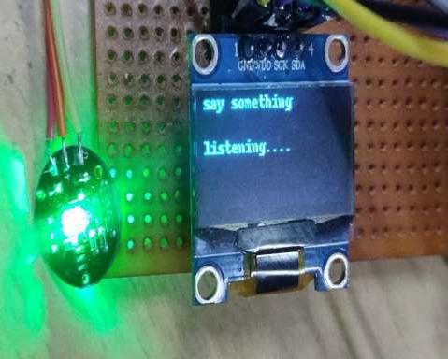
SPEECH TO TEXT ANALYSIS
input Voice Command
OLED Indication
Fig.22 Input Voice Command OLED Indication
24

Slide 25
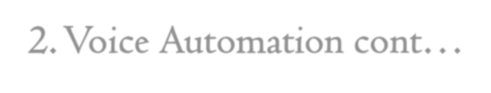




2. Voice Automation cont…
Step 2.Output Voice alerts
(Text To Speech)
Google text to Speech module converts written Text to Speech
Pre-written Text Arguments in Python Code re sent output speech generated by Google Speech API service
Input Text Pre Written Text
Python Code
Google Speech API Text to Speech Analysis Google Cloud
Output speech Voice Alerts
Speaker (“Hello.mp3)
25

Slide 26
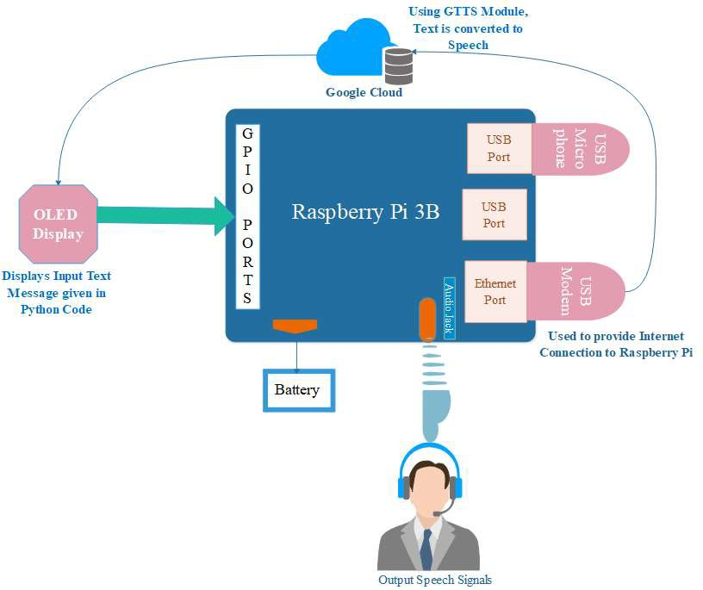
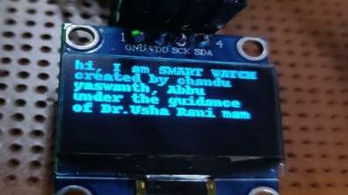
Example ( output ):
Indicates the Output speech on OLED Interface
Uses .mp3 format to play through output speaker
26

Slide 27
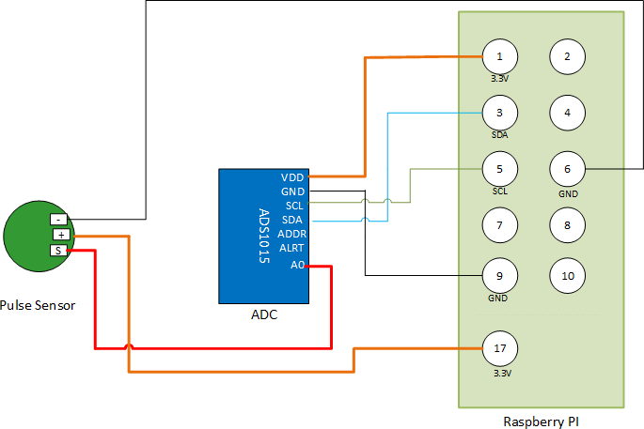
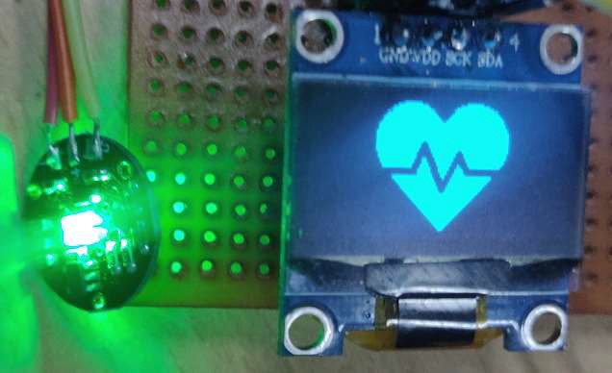
3. Sensors Interfacing
We are using Body Sensors to detect medical condition of the user , Such as
Algorithm for Interfacing Pulse Sensor
Step 1:Connecting ADS1115 and Pulse sensor to
Raspberry Pi.
Step 2:Enabling I2C options for Raspberry Pi.
Step 3:Enabling Serial interfacing also.
Step 4:Installing packages required. Step 5:Run the Python Script.
Heart Pulse Sensor
IR Temperature Sensor
Step 1: Interfacing Pulse Sensor and ADS1115 to Raspberry Pi.
Works on the principle of Photoplethysmography.
As Pulse Sensor is an Analog Sensor, ADS1115 Analog-to-Digital Converter is used to
convert Analog signals into digital signals and fed to Rpi system.
Connection Diagram of Pulse Sensor with Raspberry Pi 3
27

Slide 28

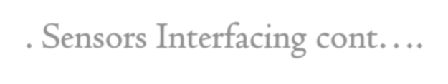
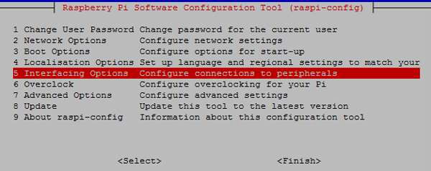
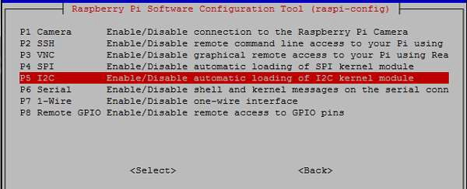
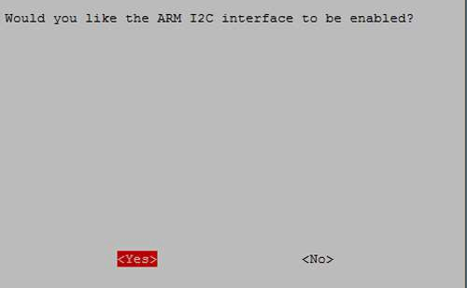
3. Sensors Interfacing cont….
Step 2: Enabling I2C options for Raspberry Pi
→To receive sensor reading we have to enable serial Communication Interfacing (IC)
Step 3: Enabling Serial interface for Raspberry Pi
→Also UART (Universal Access Receiver and Transmitter) Raspberry Pi has to enabled
for data Transfer between Sensor and Receiver
Algorithm for Interfacing Pulse Sensor
Step 1:Connecting ADS1115 and Pulse sensor to
Raspberry Pi.
Step 2:Enabling I2C options for Raspberry Pi.
Step 3:Enabling Serial interfacing also. Step 4:Installing packages required.
Step 5:Run the Python Script.
28

Slide 29

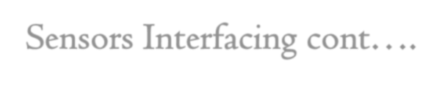

3. Sensors Interfacing cont….
Step 4: Installing packages required
The following python libraries required for Heart Rate Monitoring are
Algorithm for Interfacing Pulse Sensor
Step 1:Connecting ADS1115 and Pulse sensor to
Raspberry Pi.
Step 2:Enabling I2C options for Raspberry Pi. Step 3:Enabling Serial interfacing also.
Step 4:Installing packages required.
Step 5:Run the Python Script.
Adafruit_ADS1x15 library
Time library
IO library
sudo pip install “library_name”
Step 5: Running the python Script
python code for heartbeat monitoring is saved with the name of pulse.py and run the python code.
Python Script executes all these 5 steps mentioned Sequentially.
29

Slide 30
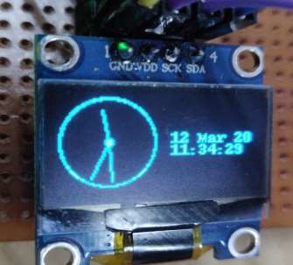
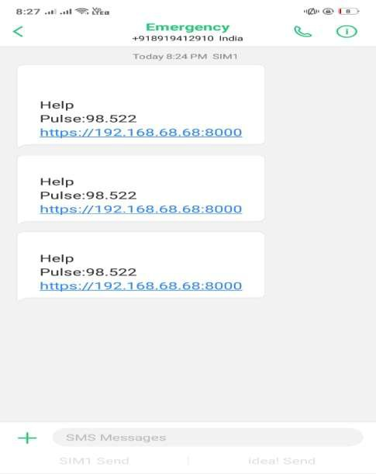
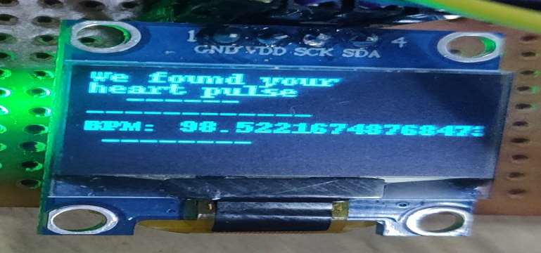
SMS Notifications
HEART PULSE (BPM)
Medical condition
(SMS Alerts to Relatives / Hospitals)
30

Slide 31
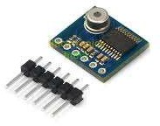
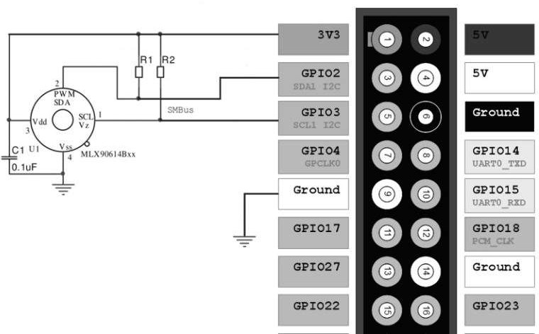
3. Sensors Interfacing cont….
Algorithm for Interfacing Pulse Sensor
Step 1:Connecting IR Body Temperature sensor
to Raspberry Pi.
Step 2:Enabling I2C options for Raspberry Pi.
Step 3:Enabling Serial interfacing also.
Step 4:Installing packages required.
Step 5:Run the Python Script.
2. Interfacing IR Body Temperature Sensor (MLX90615 )
To measure thermal temperature we are using IR (MLX90615 ) sensor
IR Body Temperature Sensor
31

Slide 32


4. Live Location Tracking
Libraries Required
Step 1: Connect GPS and GSM module to Raspberry Pi 3
Connect GPS and GSM Modules to the Raspberry Pi 3 as shown in the below
figure.
Algorithm for GPS and GSM Interfacing
Step 1:Connect GPS and GSM modules to Pi 3.
Step 2:Getting Data from GPS Module.
Step 3:Reboot the System and insert SIM card in GSM.
Step 4: Writing the Python code.
Step 5:Get message from GSM Module to phone Step 6: Live Tracking of Location is done.
Connection Diagram of GPS and GSM modules to
Raspberry Pi 3
32

Slide 33






4.Live Location Tracking cont….
Step 2: Getting Data from GPS Module.
To receive GPS co-ordinates from Satellites ,
Edit the OS boot configuration to detect GPS module
$ sudo nano /boot/config.txt
Algorithm for GPS and GSM Interfacing
Step 1:Connect GPS and GSM modules to Pi 3.
Step 2:Getting Data from GPS Module.
Step 3:Reboot the System and insert SIM card in GSM.
Step 4: Writing the Python code.
Step 5:Get message from GSM Module to phone Step 6: Live Tracking of Location is done.
Step 3: Reboot the System and Insert SIM card in GSM Module
$ sudo reboot
After Rebooting the System the GPS Module will blink.
→ This Blinking of LED in GPS Module shows that GPS Module is receiving the data.
Step 4: Execute python code
Code starts receiving latitude and longitude GPS co-ordinates.
Sends SMS Alert with Google map URL link to Client mobile phones.
33

Slide 34




4. Live Location Tracking cont….
Step 4: Executing the Python Code.
Algorithm for GPS and GSM Interfacing
Step 1:Connect GPS and GSM modules to Pi 3.
Step 2:Getting Data from GPS Module.
Step 3:Reboot the System and insert SIM card in GSM.
Step 4: Writing the Python code.
Step 5:Get message from GSM Module to phone Step 6: Live Tracking of Location is done.
34

Slide 35

By clicking on the URL Link ,redirects to the Google Maps in Client Devices
35

Slide 36



5. Calls, Messages and Notification Alerts
Step-by-Step
Setting up Raspberry Pi’s Bluetooth Pairing Raspberry Pi and Android Phone
1. Setting up Raspberry Pi’s Bluetooth
→Install bluez (Python Bluetooth Library)
Sudo apt-get install python-bluez
→Setup the Bluetooth Compatibility Mode
→Load the Serial port profile by typing this command in the terminal
sudo sdptool add SP
→Save the changes and restart the system by typing this command in the terminal.
sudo reboot
36

Slide 37





5. Calls, Messages and Notification Alerts cont….
2. Pairing Raspberry Pi and Android Phone
→Connect Raspberry Pi and mobile using Bluetooth Wirelessly.
37

Slide 38





6. Security for Smart Watch
For User Security, We are using Finger print Sensor Recognition
Components required:
→Raspberry Pi Fingerprint
→Serial USB TTL UART converter
Connection of the Raspberry Pi Fingerprint Sensor
Red: Depending on the accepted voltage of the sensor (3.3V or 5V).
White: RXD Green: TXD Black: GND
To check whether the cabling is correct and whether the sensor is detected
ls /dev/ttyUSB*
38

Slide 39



6. Security for Smart Watch cont….
Test code & example scenario
Test to see if the sensor is detected
python3 /usr/share/doc/python-fingerprint/examples/example_index.py
Save and read out
Put your finger on it again. If the fingerprint on the Raspberry Pi is detected, a message like this appears:
39

Slide 40

Hardware Setup
40

Slide 41
Start:
While Loop: (Initialize operation with the recognition of the finger print): Step 1: If (panic button activates then):
Sending Live video stream to police server. Recognize the location through GPS Sending alert message to police and family.
Go back to Step 1
Elif (panic button not activates):
Display clock on OLED Display.
Activates voice recognition.
Go back to Loop.
Else
If (pulse >170 or <50):
Sends GPS location alert messages with present pulse to family and hospital
41
Step wise Algorithm
Stop.

Slide 42

Flow Chart
42

Slide 43
Conclusion
IOT Devices alike Smart watch can help in reducing Women harassment in Society
By sending , live video streaming the incident to police authorities for verification
SMS Alerts for live GPS Location Tracking of the User
Also Body sensors useful in observing medical condition of the user and report to local hospital immediately
“We hope IOT projects like smart watch would be useful in Real-Time Situations”

Slide 44

Future Scope
1. Converting into Mobile Technology or Android OS
Converting Raspbian OS model into Android OS.
Why..?
→Raspbian OS is not good in real-time circumstances.
→Easy to build a module in Android OS.
Mobile and Smart watch are connected with the help of Wi-Fi or Bluetooth.
Full Duplex communication has to be done.
The designed App has to work in such a way that it has to receive data from the sensors in the watch and based on the inputs from the watch it has to activate mobile sensors also.
44

Slide 45











Future Scope cont….
-
If user says Video Streaming in Smart Watch.
With the help of Wi-Fi/ Bluetooth the app in the
smart phone receives the data from the watch
For Example
3. It activates the front camera of the phone and
then video streaming starts
4. We can trace the location of mobile location in
which it is near to the Smart watch
5. Calls and messages are done to family or
nearby police station if necessary.
45

Slide 46

Future Scope cont….
46

Slide 47


Implementation of Mobile App using MIT App Inventor

Slide 48

Future Scope cont….
2. Primary School Children Safety
As the school children safety are major concerns for parents as well as school management due to the recent incidents like children missing, abuse etc. This module monitors the child safety when they are travelling in school buses.
Once they reached the school the device gets deactivated by school authority and message send the parents that the child reaches the school safety.
At return journey again the device is activated by school authority and when they reached the
home, the acknowledge message is send to the school when parents deactivate the device.
The device is capable of audio recording when activated that can be listening by the parents or authorize person.
47

Slide 49

References
G C Harikiran,Karthik Menasinkai and Suhas Shirol, ”Smart Security Solution For Women Based On Internet Of Things(IOT)”,
International Conference on Electrical, Electronics, and Optimization Techniques (ICEEOT) – 2016IEEE.
Taiyang wu, Fan wu, Jean-Michel Redoute,”An Autonomous Wireless Body area Network Implementation towards IOT connected Healthcare Application”, 2016.
Alexandrous Plantelopoulous and Nikolaos.G.Bourbakis, ”A Survey on Wearable sensor based system for health monitoring and prognosis”, Vol.40, No.1, January 2010.
B.Chougula, ”Smart girls security system”,International Journal of Application or Innovation in Engineering and Management
Volume 3, Issue 4, April 2014 .
Vamil B. Sangoi, “Smart security solutions,” International Journal of Current Engineering and Technology, Vol.4, No.5, Oct-2014.
Kavita Sharma, Anand More,” Android Application for women security system”, International Journal of Advanced Research in Computer Engineering & Technology (IJARCET) Volume 5 Issue 3, March 2016
Shreyas R.S, Varun.B.C, Shiva Kumar.H.K, Punith Kumar B.E, Kalpavi.C.Y,” Design And Development Of Women Self Defence
Smart Watch Prototype”, International Journal of Advanced Research in Electronics and Communication Engineering (IJARECE)
Volume 5, Issue 4, April 2016
48

Slide 50
References
8. Vaibhav A. Alone, Ashish Manusmare,” A Study Based On Women Security System”, International Journal of
Engineering and Technology Research (IJSETR) Volume 6, Issue 8, August 2017, ISSN: 2278 -7798.
Science,
9. J.K.Thavil, V.P.Durdhawale, P.S.Elake,” Study on Smart Security Technology for Women based on IOT”, International Research Journal of Engineering and Technology (IRJET) Volume: 04 Issue: 02 Feb -2017.
10 Vamil B. Sangoi, “Smart security solutions,” International Journal ofCurrent Engineering and Technology, Vol.4, No.5, Oct-2014.
PalvePramod, “GPS Based Advanced Soldier Tracking With Emergency Messages & Communication System,” International
Journal of AdvanceResearch in Computer Science and Management Studies Research Article,Volume 2, Issue 6, June 2014.
B.Chougula, “Smart girls security system,” International Journal ofApplication or Innovation in Engineering & Management,
Volume 3, Issue 4,April 2014.
AlexandrousPlantelopoulous and Nikolaos.G.Bourbakis, “A Survey on Wearable sensor based system for health monitoring and prognosis,” IEEETransaction on system, Man and Cybernetics, Vol.40, No.1, January 2010.
Simon L. Cotton and William G. Scanlon, “Millimeter - wave Soldier – to-soldier communications for covert battlefield
operation,” IEEEcommunication Magazine, October 2009.
49

Slide 51
References
Tamil selvan, K.S, Murugesan, G, and Ashok, V. ―Embedded system based Smart Conveyor belt Security system for textile and Dyeing Industries‖, International Journal of Advanced Research in Computer Science and Software Engineering, Vol. 6, No. 7, pp, 148-152, 2016
V.Ashok,P.P.Janarthanan, Mohana Sundaram," Certain Investigation on EC-A Algorithm for Energy Minimization in
Multiprocessor Systems", Journal of Advanced Research in Dynamical and Control Systems Vol. 9. Sp– 6, 2017
Alexandrous Plantelopoulous Nikolaos G. Bourbakis "A Survey on Wearable sensor based system for healthmonitoring and prognosis" IEEE Transaction on system Man and Cybernetics</em>vol.40 no. 1 January 2010.
Palve Pramod "GPS Based Advanced Soldier Tracking With Emergency Messages & Communication System" <em>International
Journal of Advance Research in Computer Scienceand Management Studies Research Article</em> vol. 2 no. 6 June 2017.
Hock Beng Lim "A Soldier Heath Monitoring System forMilitaryApplications"<em>International Conference on Body Sensor
Networks Vol.2.15 April, 2016.
A.H.Ansari, BalsarfPratiksha P, MaghadeTejal R, YelmameSnehal M, “Women Security System using GSM & GPS”,
International Journal of Innovative Research in Science, Engineering and Technology”, Vol.6, Issue 3, March 2017.
Azhaguramyaa V R, Sangamithra D, Sindhja B, “RFID Based Security System for Women”, International Journal of Scientific &
50
Engineering Research Volume 8 Issue 5, May-2017.

Slide 52

51

